Slide 1

DATA ANALYST PORTFOLIO PROJECT
SQL + POWER BI
BY:- R Arvind

Slide 2

Intro
Project Overview
Through this project we need to analyze key indicators for our pizza sales data to gain our insights into our business performance. Specially, I calculated the following metrices:
Total Revenue Average Order Value Total Pizzas sold
Total Orders
Average Pizzas Per Order, etc.
I would also like to visualize our pizza sales data to gain insights & understand key trends such as daily trend, monthly trend, yearly trend with the help of bar graphs and charts and DAX Expressions.

Slide 3





PART-1 MYSQL SERVER
IMPORTING THE DATA
WRITING SQL QUERIES
CREATION OF DATABASE
CREATING REPORT

Slide 4





PART-2
POWER BI
CONNECTING TO MYSQL SERVER
DATA PROCESSING
CLEANING OF DATA
DATA VISUALIZATION

Slide 5



SOFTWARE USED
MS OFFICE/ EXCEL
POWER BI
MYSQL WORKBENCH 8.0

Slide 6
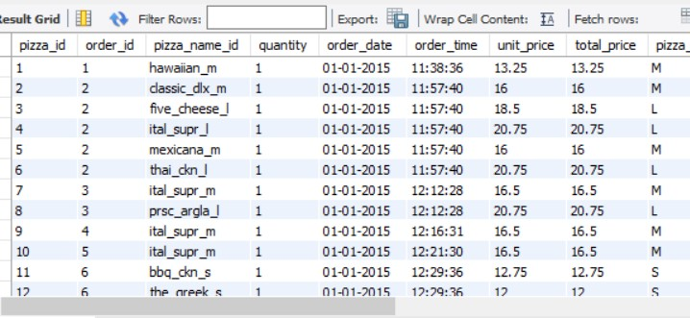
QUERY-1
Selecting all records from the particular table i.e pizza_sales
SYNTAX:
use sales_pizza;
SELECT * FROM pizza_orders;

Slide 7
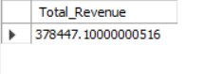
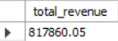
QUERY-2 (KPI’s)
Total Revenue- Sum of the total price of all orders
SYNTAX:
SELECT SUM(total_price) AS total_revenue FROM pizza_orders;

Slide 8
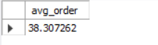
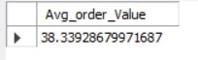
QUERY-3 (KPI’s)
Average Order value- The average amount spent per order, calculated by dividing the total revenue by total orders
SYNTAX:
SELECT (SUM(total_price) / COUNT(DISTINCT order_id)) AS avg_order from pizza_orders;

Slide 9
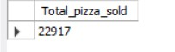

QUERY-4 (KPI’s)
Total Pizzas Sold- The sum of quantities of all pizzas sold
SYNTAX:
SELECT SUM(quantity) AS Total_pizza_sold FROM pizza_orders;

Slide 10
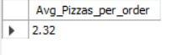
QUERY-5 (KPI’s)
Average Pizzas Per Order- Calculated by dividing the total Number of pizzas sold by total number of orders
SYNTAX:
SELECT ROUND(SUM(quantity) / COUNT(DISTINCT order_id), 2) AS Avg_Pizzas_per_order FROM pizza_orders;

Slide 11
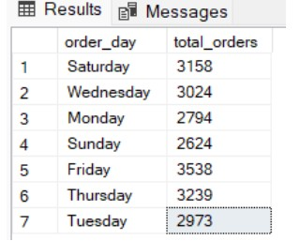
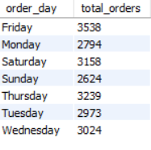
QUERY-6
Daily Trend for Total Orders
SELECT DAYNAME(order_date) AS order_day, COUNT(DISTINCT order_id) AS total_orders FROM pizza_orders GROUP BY dayname(order_date);

Slide 12
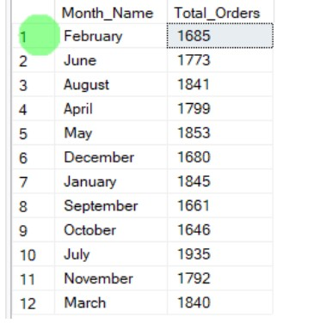
QUERY-7
Monthly Trend for Total Orders
SELECT MONTHNAME(order_date) AS Month_Name, COUNT(DISTINCT order_id) AS Total_orders FROM pizza_orders GROUP BY Month_Name;

Slide 13
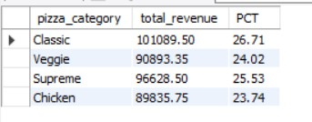
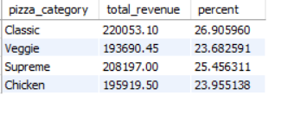
QUERY-8
% of Sales by Pizza Category
SELECT pizza_category, SUM(total_price) AS total_revenue, (SUM(total_price) / (SELECT SUM(total_price) FROM pizza_orders)) * 100 AS percent FROM pizza_orders GROUP BY pizza_category;

Slide 14
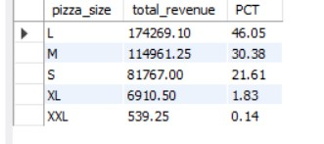
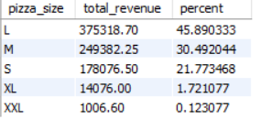
QUERY-9
% of Sales by Pizza Size
SELECT pizza_size, SUM(total_price) AS total_revenue, (SUM(total_price) / (SELECT SUM(total_price) FROM pizza_orders)) * 100 AS percent FROM pizza_orders GROUP BY pizza_size ORDER BY pizza_size;

Slide 15
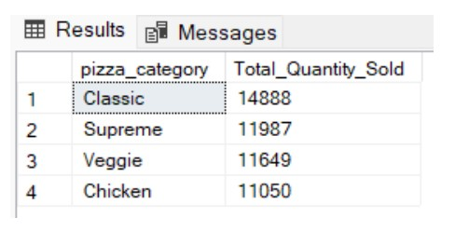
QUERY-10
Total Pizzas Sold by Pizza Category
SELECT pizza_category, SUM(quantity) AS total_quantity_sold FROM pizza_orders GROUP BY pizza_category;

Slide 16
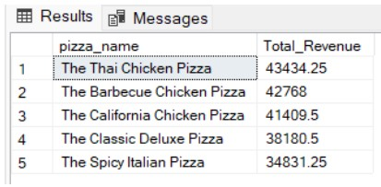
QUERY-11
Top 5 Pizzas by Revenue
SELECT pizza_name , SUM(total_price) AS Total_Revenue FROM pizza_orders GROUP BY pizza_name ORDER BY Total_Revenue DESC LIMIT 5 ;

Slide 17
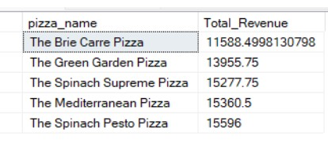
QUERY-12
Bottom 5 Pizzas by Revenue
SELECT pizza_name , SUM(total_price) AS Total_Revenue FROM pizza_orders GROUP BY pizza_name ORDER BY Total_Revenue LIMIT 5 ;

Slide 18
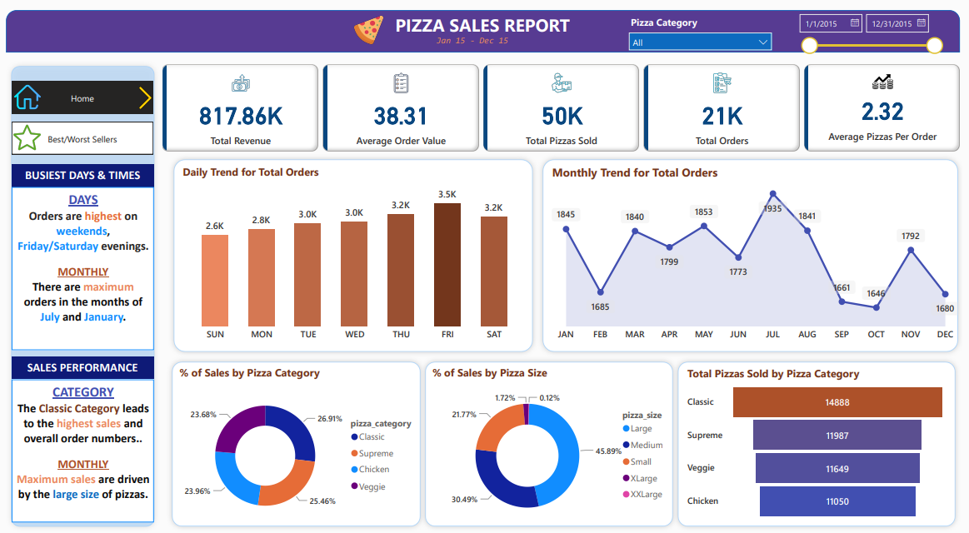
INSIGHTS
PART-2 (INSIGHTS)

Slide 19
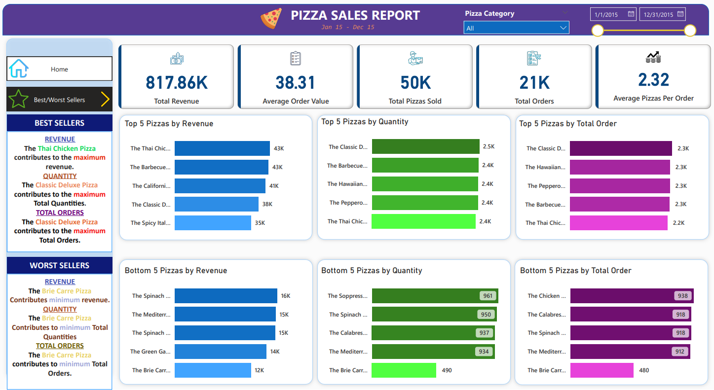
INSIGHTS
PART-2 (INSIGHTS)

